Slide 1

Scouting ADVENTURE Planning
Scouting adventures can take many forms but where do you go for help?
This course explores resources that can be used to help plan for fun scouting activities.
Doug Pedersen
dougpedersen5@gmail.com
Notes:
We are not going to hit everything. In fact we are only intending to aim for the tip of the proverbial ICEBERG

Slide 2
First Things First:
OUR AGENDA
INTRODUCTIONS
  (Name, Unit, Town, Position, Anything else☺)
SAFETY and ADULT Direct Contact Leader Training
Does if fit with the Annual Unit Program?
Plan, Revise/Replan, Prepare, Exercise, Execute (Do yer HOMEWORK)
WHAT? WHERE? WHEN? HOW
  Front Country,
  Scout Camps,
  Back Country,
  High Adventure,
  Historical,
  Urban Areas,
  General Fun Stuff
Notes:
1. County parks, local parks, state parks, private campgrounds

Slide 3
Activity Planning and Risk Assessment
Program Hazard Analysis
KNOW the Policy Regarding Prohibited and Unauthorized Activities!
Guide to Safe Scouting!
Scouter Code of Conduct
Environment (LNT, TREAD LIGHTLY)
AGE appropriate
Safe Swim Defense
Safety Afloat
Climb on Safely / Belay On
HAZARDOUS WEATHER TRAINING is REQUIRED EVERY TWO years for Direct Contact Leaders
Shooting Sports
Motorized Vehicles
Chemicals/Fuels
Power Tools
Eating Contests
Sports competitions
PPE and First Aid/Medical Information
Allergies!
TAKE A SAFETY PAUSE
Incident Reporting
Notes:
Program Hazard Analysis
This tool is primarily used for program areas within camp properties, camps or high-adventure bases. It covers specific risks to the program areas. This tool has a defined way of assessing probability and severity of risks. This tool assesses risks initially, as if there are no protective measures in place, then looks at the risks again with protective measures.
Safety PAUSE
The Safety PAUSE process stresses the importance of a last-minute safety check in the field. By encouraging each youth or adult leader to pause and reflect on the tasks at hand just before beginning, you have an opportunity to take necessary precautions to prevent any present or potential hazards.

Slide 4
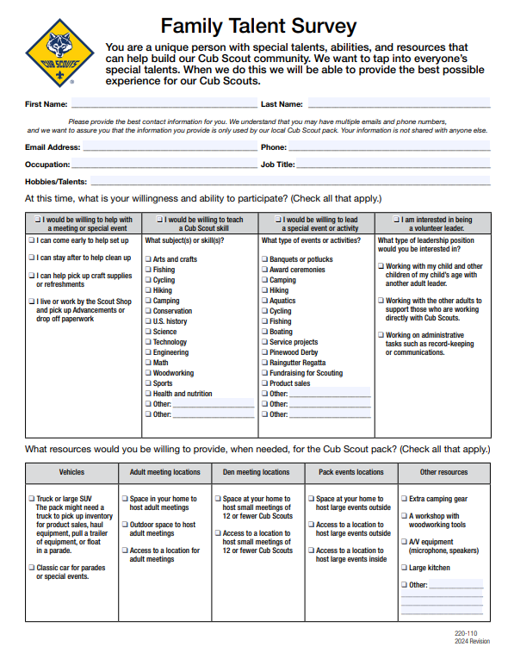
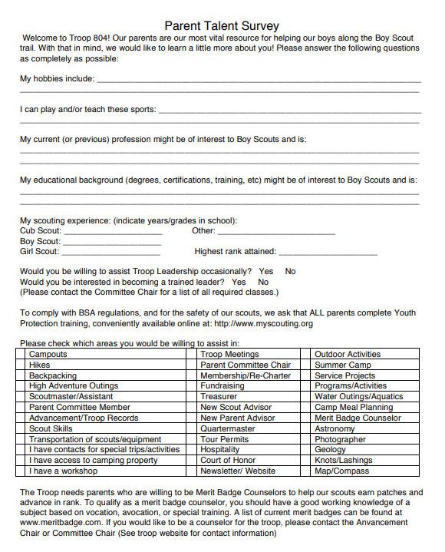
Engagement:
Notes:
Get the parents involved! If you don’t ask, the answer is NO!

Slide 5


Den Leader Resources
https://www.scouting.org/programs/cub-scouts/leader-resources/den-meeting-resources/
Scout Life
Cub Chat Live
Den Leader Tips/ Parts of a Den Meeting
  https://www.scouting.org/programs/cub-scouts/leader-resources/den-meeting-resources/
Cub Scout Fun & Games
For Each Adventure there is a supply list and Directions.
Aaron on Scouting
CubChat Live

Slide 6
CUB SCOUT PROGRAM
It’s ALL about the Adventure! Wolf (2nd graders)
Running with the Pack / Personal Fitness
Always a safety comment!
Tasting Foods (Colors BLECH!) (Protein/Vegetable/Dairy/Grain)
  What do they like?
  What don’t they like?
  What would make it better?
  Fingers vs utensils?
  https://www.scouting.org/cub-scout-activities/tasting-colors/
2. Brushing your Teeth
Chalk, Brooms
Drawing
In a sand box
BIG Cutouts of teeth or demos from a Dentist
Notes:
Think of comic strips. Think like a 7-year-old
Think attention span

Slide 7
CUB SCOUT PROGRAM
It’s ALL about the Adventure! Wolf (2nd graders)
Running with the Pack / Personal Fitness
Be Active (Kickball, Biking, Toss and Catch)
A Game of kickball is always fun
Biking
  Helmets, bikes
  RULES
    awareness
  Closed Toed Shoes
  WHERE
    Park (Canal on the NJ side)
    PICNIC
4. Personal Exercises (Trainer, Circuit, Walk)
Go For a Walk
A local Park
A nature Area
  Peace Valley, Silver Lake
  Mercer Park,
  Washington Crossing Park
  Delaware and Raritan Canal
Cub Scout Essentials
  Water, First Aid, Whistle, Flashlight, Sun protection, Trail food)
  Make it a game
Notes:
K

Slide 8
CUB SCOUT PROGRAM
It’s ALL about the Adventure! Wolf (2nd graders)
Running with the Pack / Personal Fitness
5. Relaxing Activity (MUSIC, Story Time)
Do they have a favorite Story?
  Scout Life Magazine Article
  Famous Scouts
  Scouting Adventures
Do they have a favorite song?
  Do they hear the differences between AC/DC and Bach?
6. Annual Health and Medical Record
This should be done every year
DL’s should explain that they do this with their children.

Slide 9
Arrow of Light
Five Required
  Personal Fitness
  First Aid
  Duty to God
  Citizenship
  Outdoor Adventure
TWO Electives
  Champions for Nature
  Cycling
  Engineer
  Estimations
  Fishing
  High Tech Outdoors
  Into the Wild
  Knife Safety
  Paddle Craft
  Race Time AOL
  Summertime Fun
  Swimming
Special Electives
  Archery AOL
  Slingshot
  BB Guns

Slide 10
Arrow of Light
First Aid (Personal Safety)
SAFETY Component Comes First
PROTECT YOURSELF (Video)
  Tell an ADULT
  Unsafe Touches
  Smart Choices
  Doesn’t Matter who it is
  Hitting is Wrong
  Tell them to Stop
2. First Aid Response
3. Hurry Cases, Visit a Paramedic
  Can the Squad come to you?
  Is there a parent in the Pack who is an EMT or Dr.
4. Choking Victim
  Multiple stories of Scouts helping a choking victim
  They have younger siblings.

Slide 11
Arrow of Light
First Aid (Personal Safety)
5. Shock
Shock is a life-threatening condition that occurs when the body is not getting enough blood flow. Lack of blood flow means the cells and organs do not get enough oxygen and nutrients to function properly. Many organs can be damaged as a result. Shock requires immediate treatment and can get worse very rapidly. As many as 1 in 5 people in shock will die from it.
6. Common First Aid
Cuts and scratches
  Cleaning a cut, putting on a band aid
Burns and scalds
  First degree, second degree, third degree
Bites and Stings
  TICKS,
  Bee Stings
Nosebleed
  Lean into the bleed. Pinch
  Shock potential

Slide 12
Scouting AND Venturing
YOUTH LED!
  SPL
  Communicate, Communicate, Communicate
  SM/ASM’s are there for SAFETY, SUPPORT, and guidance.
    TRAINED and EMPOWER the SPL
RESOURCES
Program Features For Troops and Crews
Troop Leader Resources
Troop Resource Survey
Scouting Magazine
Scout Life Magazine
LEAVE NO TRACE (LNT.org)
Internet

Slide 13
Plan, Revise,
Replan, Prepare, Exercise, Execute
Annual Planning and the UNIT Calendar
  12 months out (on a rolling basis)
    EXAMPLE: August/September THROUGH Next July
  Update every 6 months
    REVIST IN JANUARY
      EXAMPLE: Take the above JULY to JUNE plan
      REVISE/EDIT anything for January through JUNE
      Add/Propose to that PLAN for June through December

Slide 14
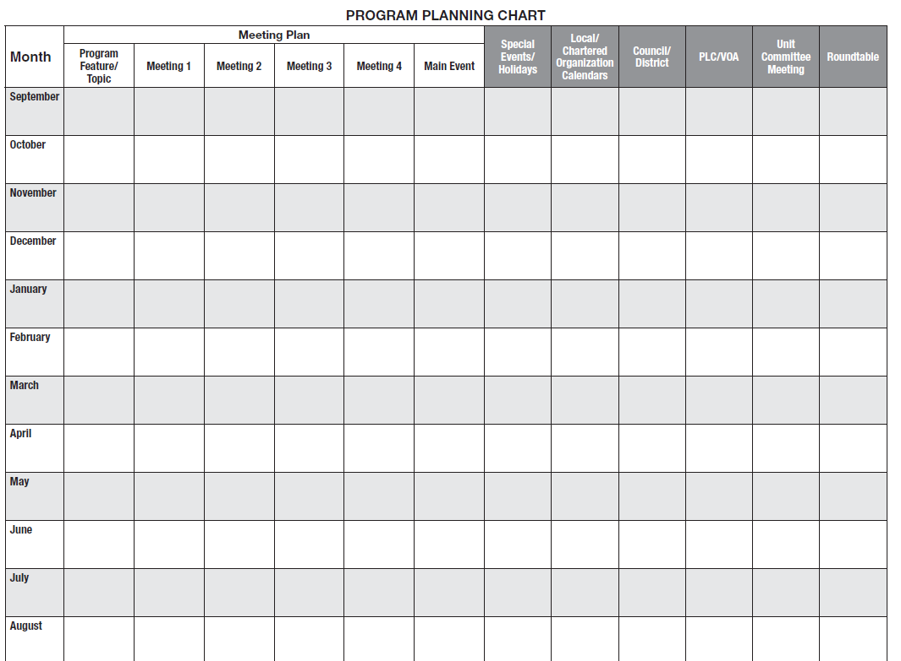

Slide 15

2014-2015
BSA TROOP 24 ACTIVITY CALENDAR
AUGUST 14 Meetings: 25 Prepare for the Year
25 TLC meeting at 7:00pm
21 Committee Meeting 7:30
__________________________________________________________________________________________________________
SEPTEMBER 14 Meetings: 8, 15, 22, 29 gym/Scout Room (No meeting on Sept 1, Labor Day)
8, 22 TLC meeting at 7:00 PM
Theme: High Adventure Event: 19-20Shooting at Wicen’s Range (tentative)
Rifle Shooting Monthly Event: 26-28 Sandy Hook,NJ Tents
18 Committee Meeting 7:30
29 Dues and Emergency form Due
___________________________________________________________________________________________________________
OCTOBER 14 Meetings: 6, 13, 20, 27 gym/Scout Room
6, 20 TLC meeting at 7:00 PM
Theme: 13 Court of Honor 7:30 PM
Geocaching High Adventure Event: 10-13Backpacking (location tbd) Tents
16 Committee Meeting 7:30
Monthly Event: 24-26 Washington, DC Tents
TBD Junior Leader Training (TLC)
___________________________________________________________________________________________________________
NOVEMBER 14 Meetings: 3, 10, 17, 24 gym/Scout Room
3, 17 TLC meeting at 7:00 PM
Theme: 20 Committee Meeting 7:30
Cooking 24 Troop 24 Indoor Rally (in Andrews Hall gym)
8, 22 LEAF RAKING--ATTENDANCE REQUIRED 9-11 am
Monthly Event: 14-16 Hawk Mountain Scout Camp, (Thanksgiving Feast) Tents
_______________________________________________________________________________________________________
DECEMBER 14 Meetings: 1, 8, 15 gym/Scout Room
1,15 TLC meeting at 7:00 PM
Theme: 18 Committee Meeting 7:30
Public Speaking Monthly Event: 13,14 Battleship NJ (overnight trip) Barracks

Slide 16
___________________________________________________________________________________________________________
JANUARY 15 Meetings: 5, 12, 19, 26 gym/Scout Room
5, 19 TLC meeting at 7:00 PM
Theme: 15 Committee Meeting 7:30
Klondike Prep Monthly Event: 23-25 Klondike Derby - Ockanickon Cabins
___________________________________________________________________________________________________________
FEBRUARY 15 Meetings: 2, 9, 16, 23 gym/Scout Room
2, 16 TLC meeting at 7:00 PM
Theme: 19 Committee Meeting 7:30
Music Monthly Events: 20-22 Snow Sports Skiing, boarding - Elk Mtn Cabin
1 Scout Sunday--ATTENDANCE REQUIRED
___________________________________________________________________________________________________________
MARCH 15 Meetings: 2,9,16, 23,30 gym/Scout Room
2, 23 TLC meeting at 7:00 PM
16 Court of Honor (Family Pot Luck) 7:30 PM
Theme: 19 Committee Meeting 7:30
Climbing Monthly Event: 20-22 Gettysburg, PA Tents
___________________________________________________________________________________________________________
APRIL 15 Meetings: 6,13, 20, 27 gym/Scout Room
6, 20 TLC meeting at 7:00 PM
Theme: 16 Committee Meeting 7:30
Fire Building/Env Sci High Adventure Event:10-12 Backpacking (location tbd)
Monthly Events: 24-26 Lenape District Camporee, TBD Tents
___________________________________________________________________________________________________________
MAY 15 Meetings: 4, 11, 18 gym/Scout Room (NO MEETING May 25, MEMORIAL DAY!)
11 TLC meeting at 7:00 PM
Theme: 4, 18 Sell Strawberry Tickets
Canoeing/Kayaking 21 Committee Meeting 7:30
Monthly Events: 15-17 Whitewater Rafting, Camp Acahela Tents
25 Memorial Day Parade
___________________________________________________________________________________________________________
JUNE 15 Meetings: 1, 8, 15, 22, 29gym/Scout Room and Burpee Park
1, 15 TLC meeting at 7:00 PM
Theme: 18 Committee Meeting 7:30
Sports High Adventure Event: 5-7 Backpacking trip, TBD Tents
15 Court of Honor (outdoors, Lake Galena)
13 STRAWBERRY FESTIVAL--ATTENDANCE REQUIRED
___________________________________________________________________________________________________________
JULY 15 Monthly Event: 12-18 Summer Camp – Resica Falls Scout Reservation Tents
___________________________________________________________________________________________________________
AUGUST 15 Meetings: 31 Prepare for the Year
27 Committee Meeting 7:30

Slide 17

VENTURING
YOUTH LED!
SEVEN STEP Process
Delfine the Specific of the Activity
Define the Resources
Consider Alternatives
Commit the Plan to Writing
Promote the Plan
Implement the Plan
Assess the Activity

Slide 18
WHAT COOL STUFF IS OUT THAR!
Front Country
  State Parks
  County Parks
  National Parks, Recreational Areas, Historical Parks, NPS Site
  Scout Camps,
  Urban Areas,
  Historical
Back Country,
  High Adventure
  Wilderness
    Backpacking/canoeing
Other or JUST Fun Stuff

Slide 19
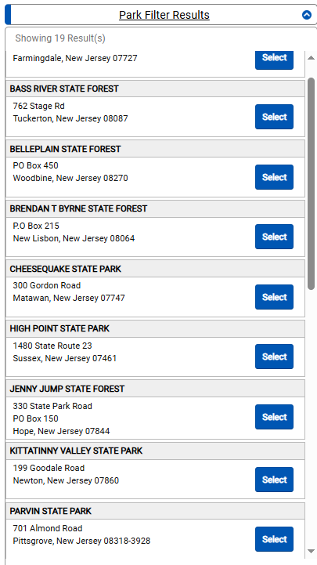
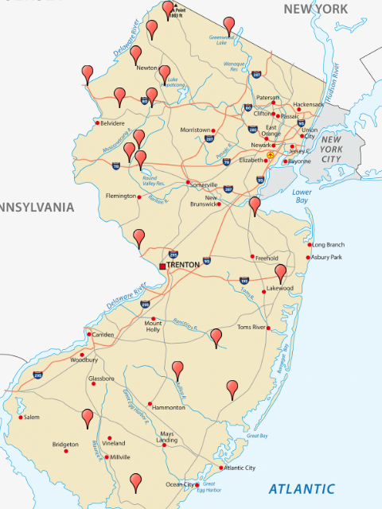
NJ State Parks https://www.njportal.com/DEP/NJOutdoors/Park/Search

Slide 20
Mercer County (https://www.mercercounty.org/visit/visit-mercer-county/historic-sites)
Louis I. Kahn Trenton Bath House
Mercer County Holocaust Resource Center
Morven Museum and Garden
Nassau Hall
National Guard Militia Museum of New Jersey
New Jersey State House
New Jersey State Museum
New Jersey State Police Museum and Learning Center
Old Barracks Museum, Trenton
Old Mill Hill District
Port Mercer Canal House, Lawrence Historical Society
Princeton Battlefield State Park
Princeton Cemetery of the Nassau Presbyterian Church
Princeton University Campus Tour
Robbins House on Hillcrest Farm
Sayen House and Gardens
Schenck House, Historical Society of West Windsor
St Mary's Cathedral
Trenton Battle Monument
Trenton Historical Society
Abbott Marshlands
Bainbridge House, Historical Society of Princeton
Benjamin Temple House at Drake Farm, Ewing Historic and Preservation Society
Brearley House, Lawrence Historical Society
Camp Olden Civil War Round Table and Museum
Crossroads of the American Revolution Association
Delaware and Raritan Canal State Park
Dorothea's House
Drumthwacket
Ellarslie Mansion
Ely House, Hightstown East-Windsor Historical Society
First Presbyterian Church
Hamilton Scrapbook Tom Glover Remembers
Hopewell Museum
Hopewell Valley Historical Society
Howell Living History Farm
Johnson Ferry House
Lawrenceville Main Street
Lawrenceville Presbyterian Church
War Memorial in Trenton
Trenton Police Museum
William Trent House Museum
PARKS
Abbott Marshlands
Baldpate Mountain
Howell Living History Farm
Mercer Meadows
Mercer County Park Marina & Spray Park
Mercer County Stables
Mercer County Tennis Center
Mercer County Park Commission Golf Courses
Tulpehaking Nature Center

Slide 21
Mercer
Princeton Battlefield State Park
Delaware & Raritan Canal Commission
NJ Trails Association
Lawrence Hopewell Trail
NJ Division of Fish & Wildlife
Assunpink Wildlife Management Area
Van Nest Wildlife Management Area
Grounds for Sculpture
Hopewell Theater
Kelsey Theatre at MCCC
McCarter Theatre
Passage Theatre Company
Patriots Theater at the War Memorial
Princeton Battlefield State Park
Princeton University Art Museum
Princeton Summer Theater
Sayen House & Gardens
Washington Crossing State Park
Notes:
We are not going to hit everything. In fact we are only intending to aim for the tip of the proverbial ICE BERG

Slide 22
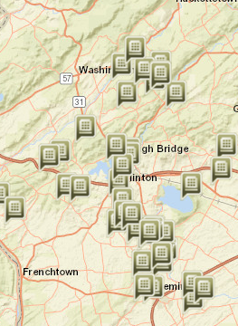
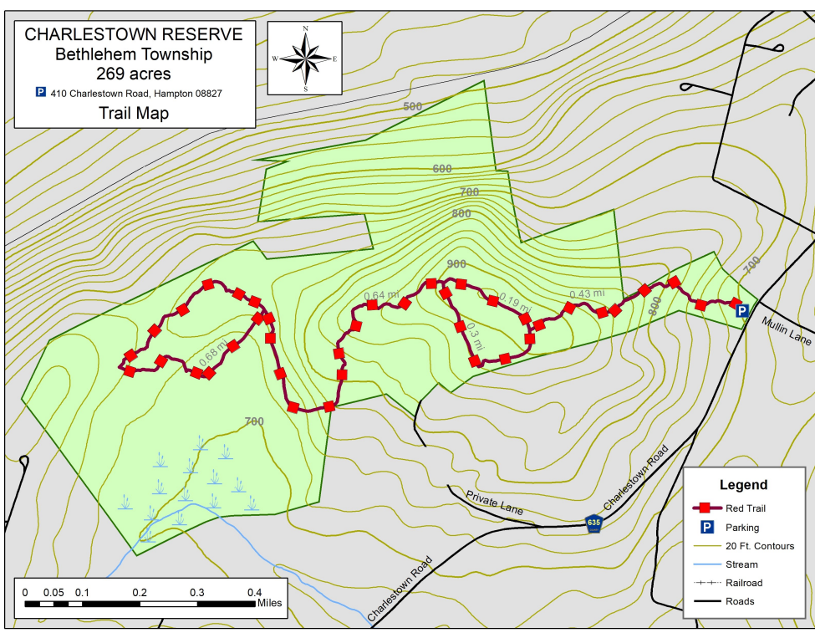
Hunterdon County (https://www.co.hunterdon.nj.us/9/Visiting) https://www.co.hunterdon.nj.us/Facilities?clear=False

Slide 23
Pa: Scenic Features https://www.pa.gov/agencies/dcnr/recreation/where-to-go/scenic-features
124 parks
ATV Riding
Biking
Boating
Cross-Country Skiing
Disc Golfing
Downhill Skiing
Fishing
Geocaching
Golfing
Hang Gliding
Hiking
Horseback Riding
Hunting
Kayaking and Canoeing
Mountain Biking
Orienteering
Picnicking
Rock Climbing
Scuba Diving
Sledding and Ice Skating
Snowmobiling
Snowshoeing
Swimming
Stay Overnight
Ceremonies in Parks
Whitewater Boating
Hiking in State Parks
Hiking trails in state parks lead to:
beautiful vistas and waterfalls
by wetlands bubbling with life
through natural areas
among dark, old growth forests
past historic places
near wildlife
by geologic features
on National Scenic Trails

Slide 24
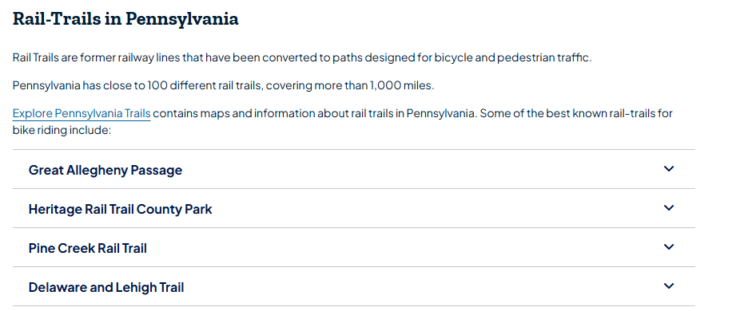
Biking in PA https://www.pa.gov/agencies/dcnr/recreation/what-to-do/biking
Benjamin Rush State ParkThe 3.5 miles of gravel, multi-use trails wander through forest and open fields and connect to the Fairmont Park system and local neighborhoods.
Big Pocono State ParkBicycles are permitted on all hard surface roads shared by vehicles.
Delaware Canal State ParkThe 60-mile long Delaware Canal towpath runs from Easton to Bristol and is a National Recreation Trail. Across the river is the Delaware and Raritan Canal State Park in New Jersey. Together, Delaware Canal State Park and D&R State Park have formed a series of looping trails connecting Pennsylvania and New Jersey via five bridges.
Fort Washington State ParkThe 2.5 mile Green Ribbon Trail provides opportunities for biking, hiking and cross-country skiing along Wissahickon Creek.
Lehigh Gorge State ParkThe Lehigh Gorge Trail is open for biking. Wide tires are recommended. Bicycle rentals and shuttle service are available throughout the area.
Locust Lake State ParkA paved, 1.3-mile long bike trail circles the lake and gives an excellent view of the lake.
Nockamixon State ParkThe popular 2-mile paved bicycle trail winds through the Day Use Area and is ideal for bicycles, strollers, wheelchairs, and walkers.
Norristown Farm ParkThere are 8-miles of trails throughout the park. Most trails are paved and used for walking, rollerblading, and bicycling.
Promised Land State ParkRiders share the road on the 6.5-mile paved road around Promised Land Lake. Bicycles are not permitted on hiking trails in the park.
Ridley Creek State ParkThe 5-mile, paved multi-use trail along Sycamore Mills and Forge roads is designated for bicycles, joggers, walkers, and cross-country skiers.
Swatara State ParkThe wide and flat Bear Hole Trail and Swatara Rail Trail are excellent trail rides on bikes with wide tires. The Northern and Southern Multi-use Loops are popular rides and comprise 11 miles of trails. There is a total of 14.8 miles of bike trails in the park.
Tyler State ParkThere are 10.5-miles of bike trails in the park. Trails are named at each intersection. Picnic tables are along the bicycle trails for rest stops.
Washington Crossing Historic ParkThe 60-mile long Delaware Canal towpath runs from Easton to Bristol and is a National Recreation Trail. It runs through the park.
White Clay Creek PreserveBicyclists may use portions of Edwin Leid Trail. Bicyclists also use the roads in and along the borders of

Slide 25
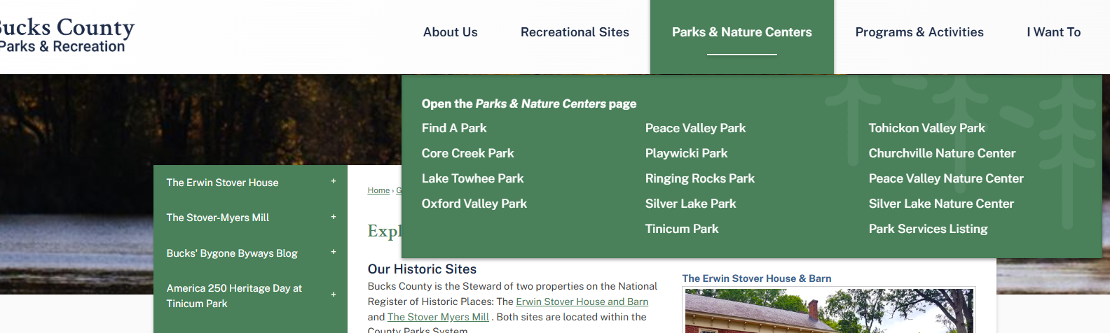

Bucks County Pa. https://www.buckscounty.gov/162/Parks-Recreation
Recreational Sites
THIRTEEN Parks, THREE Nature Centers
Programs and Activities

Slide 26
Scout Camps PA (22 Active)
Camp | Council | Town
Bashore Scout Reservation | Pennsylvania Dutch Council | Jonestown, PA
Camp Acahela | Northeastern Pennsylvania Council | Blakeslee, PA
Camp Conestoga | Westmoreland-Fayette Council | Somerset, PA
Camp Karoondinha | Susquehanna Council | Millmont
Camp Lavigne | Columbia-Montour Council | Benton, PA
Camp Minsi | Minsi Trails Council | Pocono Summit, Pennsylvania
Camp Mountain Run | Bucktail Council | DuBois, Pennsylvania
Camp Olmsted | Chief Cornplanter Council | Warren, Pennsylvania
Camp Tuckahoe | New Birth of Freedom Council
Camp Ware | Chester County Council | Peach Bottom, PA
Custaloga Town Scout Reservation | French Creek Council | Carlton, PA
Goose Pond Scout Reservation | Northeastern Pennsylvania Council | Paupack Township, PA
Camp | Council | Town
Hawk Mountain Scout Reservation | Hawk Mountain Council
Heritage Reservation | Laurel Highlands Council | Farmington, PA
Hidden Valley Scout Reservation | New Birth of Freedom Council | Loysville, PA
Horseshoe Scout Reservation^{[41]} | Chester County Council
J. Edward Mack Scout Reservation | Pennsylvania Dutch Council | Newmanstown, PA
Musser Scout Reservation | Cradle of Liberty Council
Ockanickon Scout Reservation | Washington Crossing Council | Pipersville, PA
Resica Falls Scout Reservation | Cradle of Liberty Council
Sinoquipe Scout Reservation | Mason-Dixon Council

Slide 27
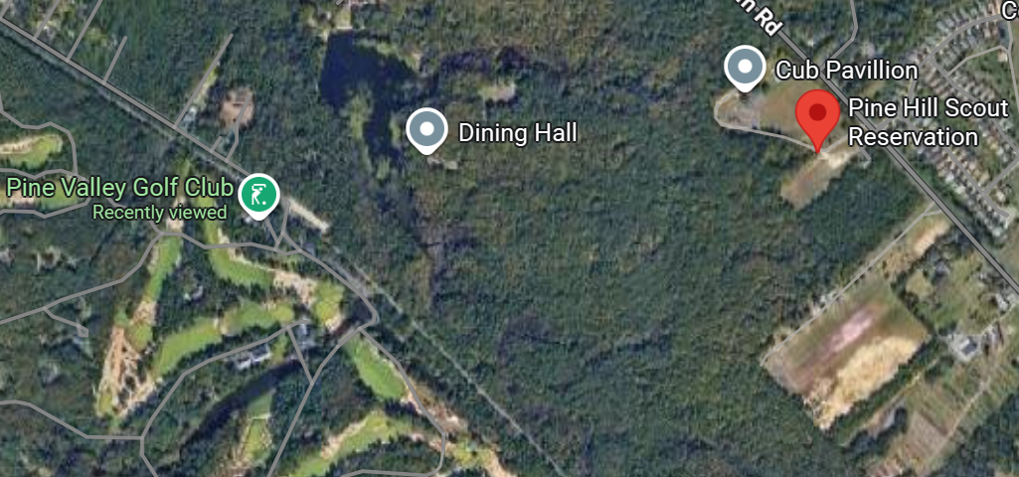
Scout CAMPS in NJ
Camp | Council | Town
Camp Grice | Garden State Council
Camp Lewis | Northern New Jersey Council | Rockaway, NJ
Camp NoBeBoSco | Northern New Jersey Council
Roosevelt Scout Reservation | Garden State Council
Camp Somers | Patriots' Path Council | Byram, NJ
Camp Watchung | Patriots' Path Council
Camp Wheeler | Patriots' Path Council | Byram, NJ
Camp Winnebago | Patriots' Path Council | Rockaway, NJ
Camp Yaw Paw | Northern New Jersey Council | Mahwah, NJ
Joseph A. Citta Scout Reservation | Jersey Shore Council | Barnegat, NJ
Mt. Allamuchy Scout Reservation | Patriots' Path Council | Byram, NJ
Pine Hill Scout Reservation | Garden State Council/Camden County | Pine Hill, NJ
Winnebago Scout Reservation | Patriots' Path Council | Rockaway, NJ

Slide 28
Scout CAMPS Regional
Camp | Council | Town
Creek Memorial Scout Reservation | Baltimore Area Council | Whiteford, Maryland
Deep Run | Baltimore Area Council
Henson Scout Reservation | Del-Mar-Va Council | Galestown, Maryland
Horseshoe Scout Reservation^{[41]} | Chester County Council
Lillie-Aaron Straus Explorer Base | Baltimore Area Council
Rodney Scout Reservation | Del-Mar-Va Council | North East, Cecil County, Maryland
Alpine Scout Camp | Greater New York Councils | Alpine, NJ
Camp Pouch | Greater New York Councils | Staten Island, NY
Henderson Scout Reservation |  | NEAR Cooperstown
Camp Alan Faye | Aloha Council | Waimea
Camp Honokaia | Aloha Council | Honokaa
Camp Maluhia | Maui County Council | Wailuku
Camp Pupukea | Aloha Council | Pupukea

Slide 29
National Park System Facilities in the Area
Parks, Recreation, Historical Parks, Monuments, Memorials
Delaware Water Gap National Recreation Area (Mt. Tammany)
Morristown National Historical Park
Gateway National Recreation Area (Sandy Hook)
NJ Pinelands
Paterson Great Falls
Thomas Edison National Historic Park
Independence NHP
Valley Forge NHP
Johnstown Flood Disaster
Thaddeus Kosciuszko NM
Fort Necessity N. Battlefield
Gettysburg NP (Youth group camping)
Hopewell Furnace NHS
Steamtown NHS
First State NHP (Delaware)
Appalachian National Scenic Trail
Notes:
Custaloga is not “too far” from French Creek State Park and Hopewell Furnace.
Camp Conewago is near Gettysburg, There is YOUTH group camping in Gettysburg. Need to plan well in advance.
Camping@vftroop73.org for camping at Valley forge

Slide 30
Back Country and High Adventure (PowderHorn)
Astronomy
Backpacking
Canoeing/Kayaking
Cave Exploring
Challenge Events/COPE
Climbing/Rappelling
Conservation
Cycling/Mountain Biking
Emergency Preparedness
Equestrian
Expedition Planning
Fishing
Geocaching
Hunting
Orienteering
Outdoor Living History
Plants and Wildlife/Ecology
Scuba and/or Snorkeling
Shooting Sports
Small-Boat Sailing/Sailboarding
Wilderness Survival
Winter Sports

Slide 31
Back Country High Adventure
Where:
  Philmont (10 days)
  SeaBase
  Northern Tier
  Alaska or OPTIK
  Canada
  Appalachian Trail (weekends to months)
    Mt. Tammany, Worthington State Forest (Mohican Outdoor Center)
    Hawk Mountain
  Batona Trail (NJ), several days
  Horseshoe Trail (140 miles)
  Ricketts Glen
  Loyalsock (16 miles)
  Old Loggers Path
  Columbia to Falmouth (Lancaster County)
Preparation
  How long (weekends to days)
  How far
  Supplies/Equipment
  Wilderness First Aid
  Leave No Trace
  Wilderness Survival
  Training

Slide 32
Biking/Mountain Biking
GAP trail and C&O Canal Towpath
  335 miles in total
  6 to 7 days.
  Great views.
  Access to towns
D&L trail, Jim Thorpe to White Haven and into Lehigh River, Easton to the Del River Canal towpath
Cape May Shoreline ride (46 miles)
  https://www.nj.gov/transportation/commuter/bike/application3/geospatialpdf/TheCapeMayShorelineRide-geo.pdf
  Not too far from Belleplain State Forest.
  Coast Guard Station (TRACEN)
Hudson Bike Loop
  https://visitnj.org/hudson-bike-loop
Henry Hudson Trail
  https://www.co.monmouth.nj.us/documents/130/Henry-Hudson-Trail-ADA-Final-2022.pdf
  24 miles, connects to Sandy Hook
D@Raritan Canal State Park (Wash. Crossing St. P)
  https://dandrcanal.org/trails
NJ Bike Trails
  https://visitnj.org/article/great-places-to-ride-bikes-new-jersey?gad_source=1&gad_campaignid=22843483373&gbraid=0AAAAADr9igcY1FcV1c6g6iMPxgdmgj0R4&gclid=Cj0KCQjw9obIBhCAARIsAGHm1mQ6z-wkaZnTdypYTauseG8zuCAMz29ihKZzT-TzXoeNhQ8UNmXflKUaAnoIEALw_wcB
Notes:
GAP Trail

Slide 33
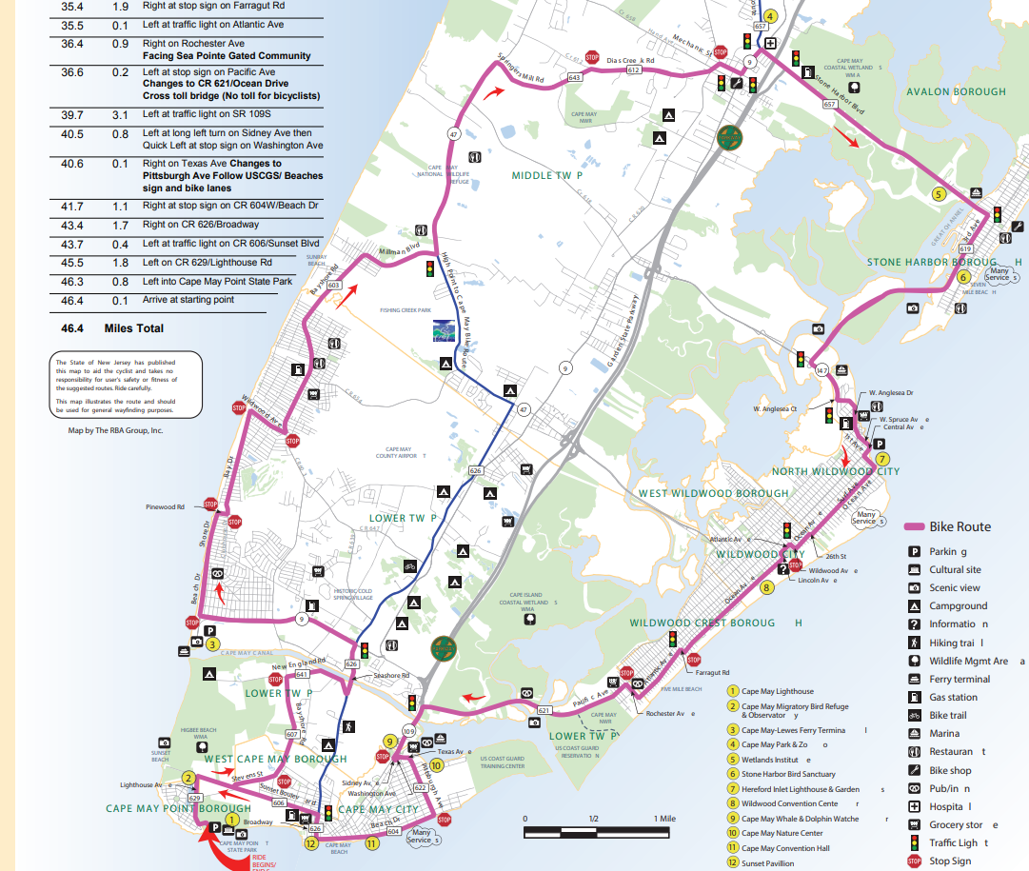

Slide 34
Resources and Places for Consideration in the Region
https://www.visitpa.com/
HTTPS://www.visitnj.org
Cooperstown, NY
Gettysburg
Monmouth Battlefield
Washington Crossing/Trenton Barracks
Fort Mott, Fort Delaware
Fort Necessity
Moravian Tile Works
Hawk Mountain
Crayola Museum
Wildwood Air museum also Air Victory Museum in Lumberton
Edelman Fossil Park (Rowan Univ)
Antietam (Sharpsburg, Md)
Manassas/Bull Run (Virginia)
Harpers Ferry
Fort McHenry
NJ Aquarium/Baltimore Aquarium
USS NJ Battleship
Trenton Planetarium
Morey’s Beach Jam, Wildwood
Six Flags, Knobles, Dorney Park (Fright Fest)
Ellis Island/Statue of Liberty
Smithsonian Museums
Franklin Institute
NY Museums Phil. Museums
Annapolis/West Point

