Slide 1

Awards Galore
Washington Crossing Council
University of Scouting
November 1, 2025
Cassandra San Jose

Slide 2
Why Awards
Youth-Encouragement, Growth, and Identity
Motivates Continued Engagement
Affirms Achievement and Effort
Builds Confidence and Identity
Teaches Goal Setting and Perseverance
Adults-Appreciation, Retention, and Role Modeling
Acknowledges Volunteer Commitment
Strengthens Retention and Morale
Sets a Positive Example for Youth
Builds Community and Legacy
Notes:
Motivates Continued Engagement Awards like merit badges, rank advancements, and honors such as the Arrow of Light or Eagle Scout inspire youth to stay active and strive for personal development.
Affirms Achievement and Effort Recognition validates the hard work, leadership, and service youth put into Scouting — especially in long-term projects or overcoming personal challenges.
Builds Confidence and Identity Receiving awards helps youth see themselves as capable leaders and contributors, reinforcing their sense of purpose and belonging.
Teaches Goal Setting and Perseverance Working toward awards teaches planning, discipline, and resilience — skills that carry into adulthood.
Acknowledges Volunteer Commitment Adults often dedicate countless hours to mentoring, organizing, and supporting youth. Awards like the Silver Beaver or District Award of Merit show that their efforts are seen and valued.
Strengthens Retention and Morale Recognition helps prevent burnout and encourages continued involvement by showing that their contributions matter.
Sets a Positive Example for Youth When adults are honored for service and leadership, it models the values of gratitude, humility, and excellence for the next generation.
Builds Community and Legacy Celebrating adult achievements fosters camaraderie and reinforces the long-term impact of Scouting on individuals and communities.

Slide 3
Type of Recognition and Awards
Ranks
  Lion, Tiger, Wolf, Bear, Webelos, Arrow of Light
Adventure Pins
Arrow of Light
Historical Awards
Lifesaving Awards
Merit badges-131
Special Awards
Cub Scout Outdoor Activity Award
Religious Emblems
Interpreter Strips
Recruiter Strip
Notes:
Starts with the BobCat Award.
Major Cub Scout Awards
Bobcat Badge: The first badge earned by new Cub Scouts, which signifies their entry into the program.
Rank Badges: These include Tiger, Wolf, Bear, and Webelos badges, which are earned by completing specific requirements for each rank.
Adventure Pins: Awarded for completing various adventures related to the Cub Scout program, focusing on different skills and interests.
Special Awards
Cub Scout Outdoor Activity Award: Recognizes participation in outdoor events and activities, which can be earned each year.
Religious Emblems: Cub Scouts can earn awards based on their faith, which may vary by religion.
Interpreter Strips: Awarded to Scouts who demonstrate proficiency in a foreign language or American Sign Language.
Recruiter Strip: Given to Scouts who successfully invite friends to join their pack.
Lion: For kindergarten-age children (typically under 6 years old). Lions learn about cooperation, citizenship, and friendship through fun activities
and adventures.
Tiger: For first graders (ages 6to7). This rank focuses on building confidence, family values, and engaging in outdoor
activities.
Wolf: For second graders (ages 7to8). Wolves work on personal growth, physical fitness, and community involvement t
hrough various adventures.
Bear: For third graders (ages 8-9). This rank emphasizes hobbies, physical fitness, and learning about one’s community.
Webelos: For fourth graders (ages 9to10). Webelos scouts focus on leadership skills and preparing to transition to Scouts
BSA.
Arrow of Light (AOL): For fifth graders (ages 10to11). This is the highest rank in Cub Scouts and signifies readiness to join a Scouts BSA troop.

Slide 4
Type of Recognition and Awards
Senior Patrol Leader
Assistant Senior Patrol Leader
Patrol Leader
Troop Guide
Quartermaster
Scribe
Den Chief
Chaplain Aide
Historian
Instructor
Librarian
Webmaster
Bugler
Order of the Arrow Representative
Outdoor Ethics Guide
Junior Assistant Scoutmaster
Ranks
  Scout, Tenderfoot, Second class, First class, Star, Life, Eagle, Eagle Palms
Merit badges-131
21 Merit madges for eagle
  14 Eagle required
  7 additional
NYLT
Order of the Arrow
  Ordeal
  Brotherhood
  Vigil

Slide 5
Venturing and Sea Scouts
Venturing Award
Discovery Award
Pathfinder Award
Summit Award
Specialty Awards
Long Cruise Badge
Qualified Seaman Program
Sea Scout Leadership Award
Basic Shooter Award
Finley Sea Scout Service Award
Notes:
Venturing Award: The starting point for Venturers.
Discovery Award: Recognizes Venturers who demonstrate leadership and service.
Pathfinder Award: For those who show leadership and service in a more advanced role.
Summit Award: The highest rank, equivalent to the Eagle rank in traditional Scouting.
Specialty Awards: Such as the Ranger Award, Quest Award, TRUST Award, and Nova Awards, which focus on outdoor skills, sports, faith, and science.
These awards help Venturers develop their skills and demonstrate their commitment to the Venturing program.
Long Cruise Badge: Recognizes Sea Scouts who cruise for two weeks on a vessel provided by the council or their own vessel.
Qualified Seaman Program: Offers training in boating safety and seamanship skills.
Sea Scout Leadership Award: Presented to Sea Scouts and adult leaders for exceptional contributions to the program.
Basic Shooter Award: Recognizes Sea Scouts who achieve shooting proficiency in various disciplines.
Finley Sea Scout Service Award: Honors Sea Scouts who provide outstanding leadership and service.
These awards reflect the skills, leadership, and community service that Sea Scouts demonstrate throughout their time in the program.

Slide 6
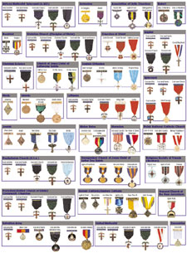
Religious
Emblems
Religious Emblems Programs | Scouting America

Slide 7
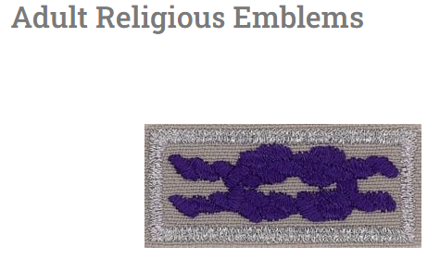
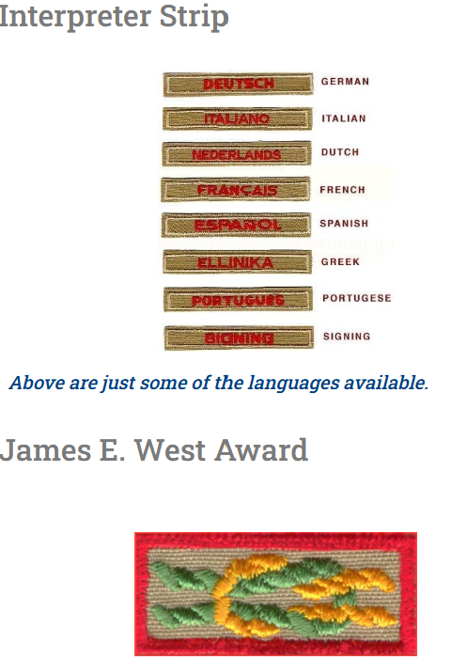
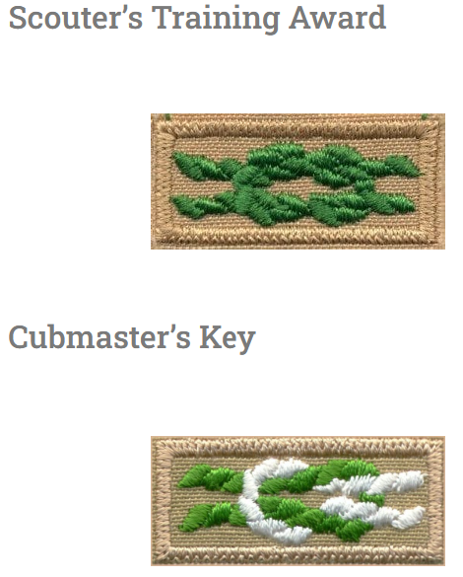
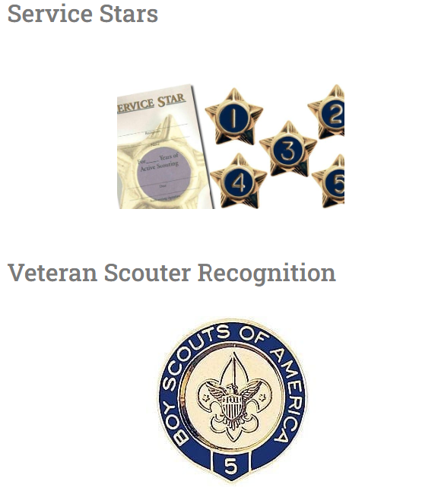
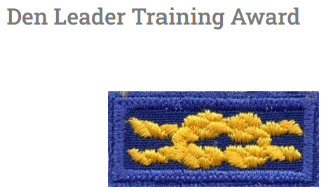
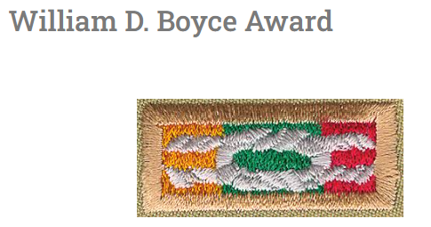
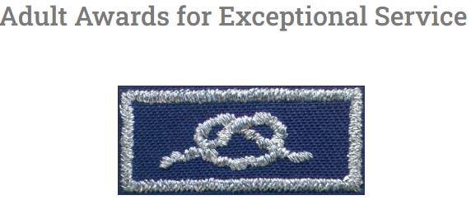
Adult Awards

Slide 8

Den Leader Training Award
Tenure: Complete one year as a registered den leader in any of the positions (Tiger Cub, Wolf, Bear, or Webelos). The tenure can only be counted for one award, even if the leader serves in multiple positions.
Training: Complete the basic training for the selected den leader position, which can be done through in-person, instructor-led or e-learning sessions.
Participation: Attend a pow wow or university of Scouting (or equivalent) or participate in at least four roundtables during the tenure used for this award.
Notes:
The Den Leader Training Award recognizes Cub Scout leaders who complete specific training and performance requirements, enhancing their leadership skills and contributions to the program.

Slide 9
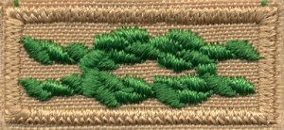
Scouter Training AWard
Tenure: Serve for at least two years in a registered volunteer position.
Training: Complete the basic training for their specific program area.
Performance: Demonstrate satisfactory performance in their role, which may include fulfilling specific responsibilities and participating in Scouting activities.
Notes:
The Scouter Training Award Knot recognizes registered adult volunteers who complete training and performance requirements while serving in various Scouting positions.

Slide 10
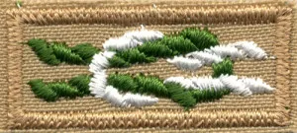
Scouters Key
Training: Complete basic training for your specific role, such as Scoutmaster or Cubmaster, and participate in additional training courses beyond the basic level.
Tenure: Serve a minimum of three years in a registered leadership position within a five-year period.
Performance Goals: Achieve specific performance goals, such as conducting youth leader training and participating in district or council activities.
Supplemental Training: Participate in at least one supplemental training course at the local council or national level.

Slide 11
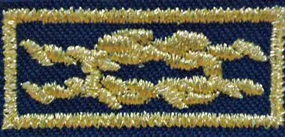
Unit Leader Award of Merit
Be a currently registered Cubmaster, Scoutmaster, Advisor, or Skipper.
Have served in that position for at least 18 continuous months.
Meet the training requirements for their registered position.
Distribute an annual unit program plan and calendar to each family in the unit.
Have a leader succession plan in place.
Ensure that at least 60% of the unit’s youth have advanced at least once during the last 12 months.
Cultivate a positive relationship with the chartered organization and project a positive image of Scouting in the community.
Notes:
The Unit Leader Award of Merit is designed to honor quality unit leaders within the Boy Scouts of America (BSA). This award acknowledges the significant role that effective leadership plays in enhancing the Scouting experience and improving Scout retention. It replaced previous awards such as the Scoutmaster Award of Merit and the Venturing Crew Advisor's Award of Merit.

Slide 12
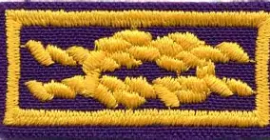
Community Organization award
Community Organization Award is a generic term used by the BSA to identify a category of awards used by secular, national, community organizations to recognize their members for voluntary service and achievement. The organization must also be a BSA national chartered organization. The recognition piece, the concept of the award, and the criteria for awarding and presenting it are developed and owned by the national community organization which is also a chartered organization with the Boy Scouts of America. To ensure compatibility with the objectives and mission of the Boy Scouts of America, the concept, requirements, and criteria for presenting the award must be approved by the BSA National Relationships Committee.
Notes:
The Boy Scouts of America's Community Organization Award square knot (shown above) consists of an embroidered gold square knot on a purple background with a gold border and is the means by which the BSA recognizes Scouters who have received an approved community organization service recognition. As with all other square knots, it is worn on the Scouter uniform shirt above the left pocket.

Slide 13
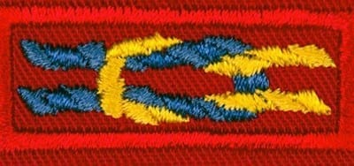
¡Scouting… Vale la Pena! Service Award
The ¡Scouting … Vale la Pena! Service Award is a prestigious recognition in Scouting America that honors outstanding services by individuals or organizations in the Hispanic American/Latino community. This award is presented to those who have made significant contributions to the development and implementation of Scouting opportunities for Hispanic youth. The award is presented to people at all levels of the Scouting Community.
Notes:
Presented by the local council, which also sets the qualifications.

Slide 14
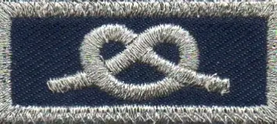
District Award of Merit
Nomination Process: Candidates for the District Award of Merit must be nominated by others; self-nominations are not allowed. The nomination must be submitted to the district committee for consideration.
Service Requirement: Typically, nominees should have provided service to youth for a minimum of five years, demonstrating a consistent commitment to scouting and community service.
Multiple Awards: A person may receive the District Award of Merit more than once from different districts, but there are no provisions for wearing more than one award at a time.
Notes:
The District Award of Merit is awarded by a district within the Boy Scouts of America (BSA) to both volunteer and professional adults who have rendered noteworthy service to youth in their district. This award is significant as it acknowledges the contributions of individuals who go above and beyond in their service to scouting and the community. Unit Committee Chair fills out the application.

Slide 15
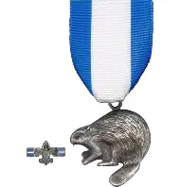
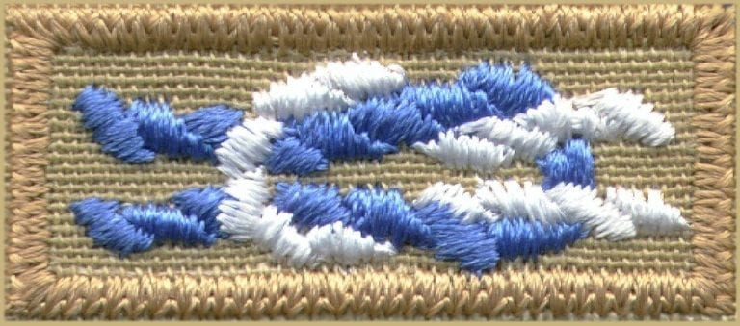
Silver Beaver
The Silver Beaver Award was introduced in 1931 and is the highest recognition that a local council can bestow on a volunteer Scouter. It is awarded for distinguished service to youth within a local council and acknowledges the hard work and dedication of Scouters who have significantly impacted the lives of young people.
Nomination Process: Anyone may nominate any deserving registered Scouter to the council, which selects recipients for the following year.
Notes:
Medal on blue and white ribbon, SB knot, SB pin.

Slide 16
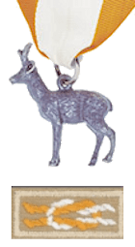
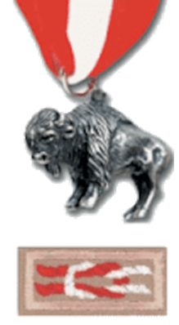
Silver Antelope
Silver Buffalo
Beyond service to the local council, the Silver Antelope is given at the regional level and the Silver Buffalo is given at the national level. These are presented at the National Annual Meeting of Scouting America.
Notes:
Like the Silver Beaver, but at a higher level of Scouting.

Slide 17
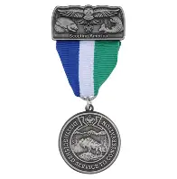

Scouting America Distinguished Conservationist Award
This award is by nomination only and is for an adult Scouter who has rendered distinguished and exemplary service to natural resource conservation and environmental improvement over a sustained period (at least 20 years). The focus of the award nomination should be on the nominee’s involvement with youth, especially in the areas of education and volunteerism and inspiring them to excel in conservation, natural resources management and environmental improvement. The nominee’s accomplishments must be at a regional, national, or international level. Nominations are accepted from any recognized conservation or environmental
protection organization.

Slide 18
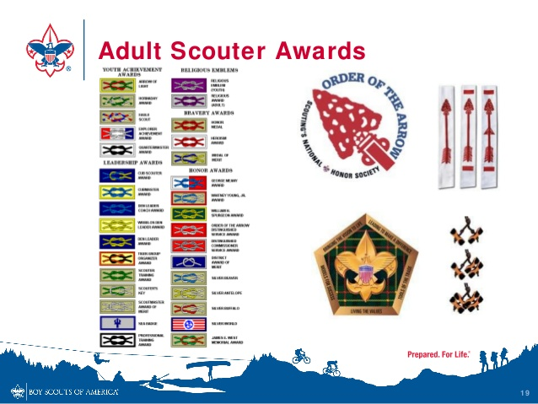

Slide 19
What else
Scholarships | Scouting America
World Conservation award
Emergency Preparedness
Physical Fitness
Notes:
Additional Recognitions
World Conservation Award: Encourages Scouts to learn about conservation and environmental stewardship.
Emergency Preparedness Award: Recognizes Scouts who learn about safety and preparedness in emergencies.
Physical Fitness Award: Encourages Scouts to engage in physical activities and maintain a healthy lifestyle.
These awards not only help Cub Scouts develop new skills but also foster a sense of accomplishment and community within their packs. For more detailed information on each award and its requirements, you can refer to the official Cub Scout resources or local scouting websites.

Slide 20
Awards Central
#
50-Miler Award (For Youth and Adult)
A
Asian American Spirit of Scouting Service Award (For Youth)
Alumni Award (For Adult)
B
Boardsailing BSA Award (For Youth and Adult)
BSA Lifeguard Award (For Youth and Adult)
BSA Stand up Paddle Boarding Award (For Youth)
BSA Distinguished Conservation Service Award (For Youth and Adult)
C
Commissioner Awards and Recognitions (For Adult)
Community Organization Award (For Adult)
Conservation Good Turn Award (For Youth)
Complete Angler (For Youth)
Council Alumnus of the Year Award (For Adult)
Council Duty to God Award (For Adult)
Cub Scout Leader Recognition Awards (For Adult)
D
Den Chief Service Award (For Youth)
Den Leader Training Awards (For Adult)
Distinguished Conservation Service Award (For Youth and Adult)
Distinguished Eagle Scout Award (For Adult)
District Award of Merit (For Adult)
E
Eagle Palms (For Youth)
Elbert K.Fretwell Outstanding Educator Award (For Adult)
Exploring Awards and Recognitions (For Youth and Adult)
F
Firem’n Chit Award (For Youth)
Founders Bar Award (For Youth and Adult)
Frank L. Weil Memorial Quality Jewish Committee Award (For Adult)
Frank L. Weil Memorial Unit Recognition Award (For Unit)
G
George Meany Award (For Adult)
Good Turn Society Award (For Adult)
Glenn A. and Melinda W. Adams National Eagle Scout Service Project of the Year Award (For Youth)
Grand Slam High Adventure Award (For Youth and Adult)
H
Historic Trails Award (For Youth and Adult)
I
International Scouter’s Award (For Adult)
International Spirit Award (For Youth)
Interpreter Strip Award (For Youth and Adult)
J
James E. West Fellowship (For Youth and Adult)
Jimmy Stewart Award (For Youth and Adult)
K
Kayaking Scouting America (For Youth and Adult)
L
Lifesaving and Meritorious Action Award (For Youth)
Long Cruise Award (For Youth and Adult)
M
Memorial Gold Star Award (For Youth and Adult)
Messengers of Peace Award (For Youth and Adult)
Mile Swim BSA Award (For Youth and Adult)
N
National Duty to God Award (For Youth and Adult)
National Honor Patrol Award (For Youth)
National Major Gift Award (For Adult)
National Outdoor Award (For Youth)
NESA Life Membership Award (For Adult)
NESA Outstanding Eagle Scout Award (For Adult)
North Star Award (For Adult)
Nova Awards Program (For Youth)

Slide 21
Awards Central
O
Order of the Arrow—Distinguished Service Award (For Youth and Adult)
Order of the Arrow—Founder’s Award (For Youth and Adult)
Order of the Arrow—Red Arrow Award (For Adult)
Order of the Arrow—Vigil Honor (For Youth and Adult)
Outdoor Ethics Awareness and Action Award (For Youth)
P
Paul Bunyan Award (For Youth)
Philmont Training Center Masters Track Award (For Adult)
Polar Bear Award (For Youth and Adult)
Professional Circle Award (For Adult)
Professional Fellowship Honor (For Adult)
Q
Qualified Seaman Award (For Youth and Adult)
R
Recruiter Strip Award (For Youth)
Religious Emblems Awards Program (For Youth and Adult)
S
iScouting…Vale la Pena! Service Award (For Adult)
Scholarships (For Youth)
Scouter’s Key Award (For Adult)
Scouter’s Training Award (For Adult)
Scuba BSA Award (For Youth and Adult)
Sea Scout Leadership Award (For Youth)
Sea Scout Service Award (For Youth and Adult)
Service Stars Award (For Youth and Adult)
Silver Antelope Award (For Adult)
Silver Beaver Award (For Adult)
Silver Buffalo Award (For Adult)
Skipper’s Key Award (For Adult)
Small Boat Handler Award (For Youth and Adult)
Snorkeling BSA Award (For Youth and Adult)
Special Needs Scouting Service Award (For Adult)
Spirit of the Eagle Award (For Youth)
T
Totin’ Chip Award (For Youth)
Torch of Gold Award (For Youth and Adult)
Trained Strip (For Youth and Adult)
Triple Crown High Adventure Award (For Youth and Adult)
U
Unit Leader Award of Merit (For Adult)
V
Venturing Leadership Award (For Youth and Adult)
Venturing Other Awards and Recognitions (For Youth and Adult)
Venturing Shooting Sports Outstanding Achievement Award (For Youth)
Veteran Award (For Adult)
Veteran Unit Award (For Youth and Adult)
W
W.P. Society Award (For Adult)
Whitewater Rafting BSA Award (For Youth and Adult)
Whitney M. Young Jr. Service Award (For Adult)
William D. Boyce New-Unit Organizer Award (For Adult)
Winthrop Rockefeller Award (For Adult)
World Conservation Award (For Youth)
Woods Services Award (For Adult)

Slide 22
Awards Central | Scouting America
Guide to Awards and Insignia | Scouting America
01:50 Mini-Breakout: Scouter Awards Series Intro YouTubePacific Trail District Roundtable9.7K viewsJul 15, 2015

